Slide 1

Welcome
Mr. McGrath
Mr. Anthony
Ms. Nikki
Ms. anaa

Slide 2
Classroom Rules
Raise your hand when you have a question or something to say. Do not call out.
Electronic devices are not permitted in this classroom. If I see it, I take it. Handhelds such as a Switch or a tablet are allowed only during designated times.
Keep your desk and work area neat and clean. If you need cleaning supplies, please ask.
Use respectful and appropriate language at all times. Bullying is not tolerated and will be dealt with harshly.
Do not stand in the doorway for any reason ever. I will scream at you so loud your hair will stand up straight.

Slide 3
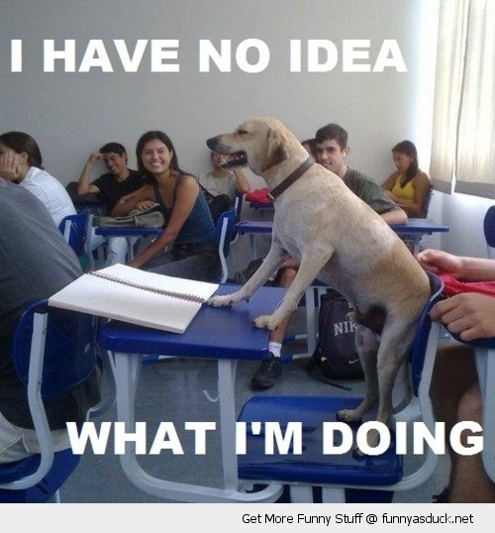
There are no assigned seats.
However, the staff can move you to another desk as we see fit. No matter where you choose to sit, you are expected to keep your space clean and organized. Cleanliness and neatness are a priority in C6.

Slide 4
Expectations
You are expected to arrive to school on time and prepared to work. If you are absent or late, it is up to YOU to ask ME for missing assignments, not the other way around.
You are expected to bring pens, pencils, and other supplies every day. I am not an employee of Staples.
You are expected to remain seated during instructional time. If you need something, raise your hand or seek the attention of a para or I appropriately.
You are expected to work hard and complete all assignments. Incomplete assignments will either be made up or your grades will suffer.

Slide 5

You are expected to use appropriate methods and tools when you feel frustrated or overwhelmed.
You are expected to enter and exit this classroom in a calm manner at all times.

Slide 6
Transitioning
When we go from class to class, or are walking in the hallway, you are expected to behave with maturity. You will be attending high school next year. Act like it.
When we transition to another class within the classroom, you are expected to take out all the materials necessary for the next class when instructed to do so.

Slide 7

Everyone has the potential to succeed in ELA.
All it takes is effort, motivation, and a belief that you can do well everyday.

Slide 8
Daily Ela class
ELA will have two daily components:
1. Reading
2.Writing
That means that every day you will have the opportunity to read and to write on a variety of topics.

Slide 9

Not everyone has the exact same skills and abilities.
Some of us are good at sports, some of us are good at video games, and some of us are good at reading. We are all on the same team in this classroom. We help each other to be better every day. Bullying, making fun of, or putting someone down is not tolerated in this room.

Slide 10
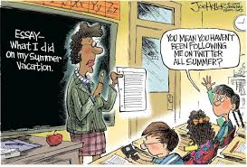
If you struggle with reading, don’t worry! It’s my job to help you!

Slide 11
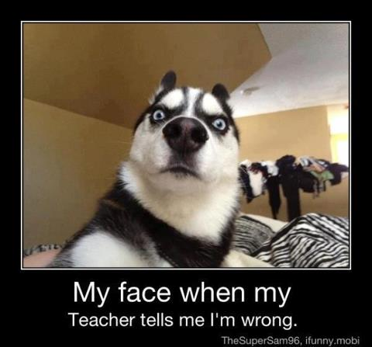
If you struggle to write, don’t worry! I will help you every step of the way.

Slide 12
Materials - notebook
Once you are supplied with a notebook, that notebook will remain with me in the classroom unless I instruct you to take it home.
You are expected to keep your notebook neat and orderly. Foul language or obscenities of any kind are not permitted.

Slide 13
Materials - folder
Your folder will remain in the classroom until you are instructed to take it home.
When you take it home, you are expected to show your parent or guardian the entire contents of the folder and return it the next day. There will be a consequence for failing to do so.

Slide 14
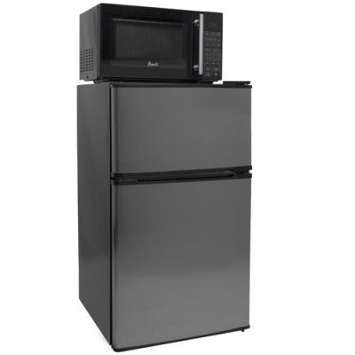
Fridge and microwave
The fridge and the microwave are MINE. I bought them and installed them. They are for my colleagues and myself. IF you want to use them you must ask MY permission. You are not allowed near them or to use them yourself, no matter what Gordon Ramsay has to say about your culinary skills.

Slide 15
Our classroom
Our classroom is our home away from home. Treat this room with respect. Keep it clean. Keep it neat. Keep it organized. Clean up after yourself. Help your classmates stay organized and on task. Push your chair in when leaving the room. Through all trash away. Wipe your desk down when it gets messy. We will all be better for it!

Slide 16
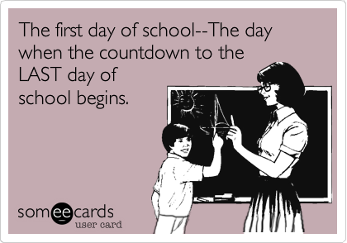
2021-2022
Don’t worry! We are going to have a great year filled with interesting lessons, great books, fun trips, cool rewards, and wonderful times together!

